Slide 1
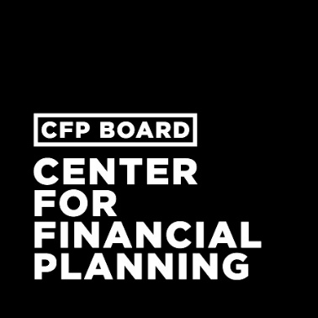
FINANCIAL PLANNING AS A CAREER
Career Benefits and Process to Become a
Certified financial planner™ professional

Slide 2
AGENDA
The Importance of Financial Planning
Financial Planning as a Career
What is CFP® Certification?
Benefits of CFP® Certification
How to Become a CFP® Professional
Resources

Slide 3
ABOUT ME
When you became a CFP® professional/how long you’ve been in the profession
Firm/company affiliations
Relevant publications/speaking roles
Involvement with CFP Board/the Center
Notes:
TO BE CUSTOMIZED BY SPEAKER

Slide 4


ABOUT CFP BOARD AND
CENTER FOR FINANCIAL PLANNING
Certified Financial Planner Board of Standards (CFP Board)
Grants CFP® certification and upholds it as the recognized standard of excellence for competent and ethical personal financial planning.
CFP Board Center for Financial Planning
Seeks to create a more diverse and sustainable financial planning profession so that all Americans can access competent and ethical financial planning advice.
Notes:
I call myself a CFP® professional because I am certified to practice financial planning by the Certified Financial Planner Board of Standard, or CFP Board.
CFP Board is a non-profit organization that acts in the public interest by creating and upholding the standards for being a CFP® professional. These standards include educational, examination, experience, and ethical requirements, among others, which we’ll talk more about later.
There are currently more than 81,000 CERTIFIED FINANCAL PLANNER™ professionals in the U.S. While this may seem like a large number, it is not enough to meet Americans’ growing demand for financial advice. In fact, the financial planning workforce is aging and shrinking, and it does not currently represent the diverse population it serves.
To address these challenges, CFP Board partnered with stakeholders across the financial planning profession to establish the Center for Financial Planning in 2016. Since then, the Center has worked to create a more diverse and sustainable financial planning profession that provides every American with the competent and ethical financial planning advice they need.

Slide 5
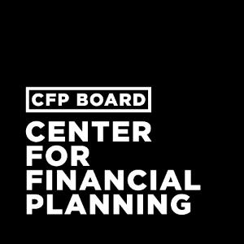
The importance of financial planning
1
Notes:
Before we talk about careers in financial planning and CFP® certification in greater detail, I would like to take a little time to talk about the importance of financial planning.

Slide 6
WHAT IS FINANCIAL PLANNING?
Financial Planning is a collaborative process that helps maximize a Client’s potential for meeting life goals through Financial Advice that integrates relevant elements of the Client’s personal and financial circumstances.
Financial Planning integrates the following:
GENERAL FINANCIAL PLANNING
INSURANCE PLANNING & RISK MANAGEMENT
ESTATE PLANNING
RETIREMENT PLANNING
INVESTMENTS
INCOME TAX PLANNING
EMPLOYEE BENEFITS
Notes:
At a fundamental level, financial planning is a collaborative process involving a client and a financial advisor.
We work together to determine the client’s life goals – whether they want to buy a house, pay for their kids’ education, or retire early and travel the world – and then maximize their potential to achieve those goals.
A successful financial plan integrates relevant elements of the client’s personal and financial circumstances. It encompasses everything from investments and retirement planning to insurance planning and risk management, income tax planning, and estate planning.

Slide 7
BENEFITS OF FINANCIAL PLANNING
A solid financial plan puts you in control of your future
Take the guesswork out of managing your finances
Set short- and long-term goals
Understand the implications of your financial decisions
Make sense of options for saving and investing
Avoid financial setbacks
Deal with major life changes
Avoid debt and credit problems
Retire comfortably and on your timeline
Enjoy peace of mind
Notes:
Why make a financial plan? Because it puts you in control of your future.
With a solid financial plan in place, it’s easier for you to make financial decisions, set long- and short-term goals, and make sure you are on track to achieve those goals.
A financial plan also helps you respond to life changes while avoiding major setbacks and debt or credit problems.
A successful financial plan brings all the pieces of your financial life together to give you peace of mind, and that is what a CFP® professional can do for their clients.

Slide 8
FINANCIAL PLANNING as a career
2
Notes:
Many of you may never have considered working with a financial advisor, let alone becoming one. You may be wondering what’s so great about a career in financial planning. Let’s take a minute to hear what a few other CFP® professionals have to say.

Slide 9
ADD: “I Am a CFP® Pro” Video
HOLD FOR BRITTNEY CASTRO VIDEO

Slide 10

PEOPLE-FOCUSED PROFESSION
It’s not all about math and investments
Requires creative problem solving, relationship building, communication skills
Holistic, “big picture” look at clients’ finances to help them reach their goals
Objective advice on budgeting, retirement, education planning, taxes, insurance, estate planning, etc.
Notes:
One of the biggest misconceptions of financial planning is that it’s primarily about math and crunching numbers. Similarly, many people think financial planning is synonymous with investment management.
But as you heard in the video, we’re not up at dawn watching stock tickers, nor do we spend our days poring over spreadsheets.
In reality, our focus is on people. Building relationships and trust with your clients, communication skills, and creative problem solving are all key to a successful financial planning career.
CFP® pros also take a holistic, big picture look at our clients’ finances to help them reach their goals, as I alluded to before. Investment strategy is just a part of that picture.

Slide 11
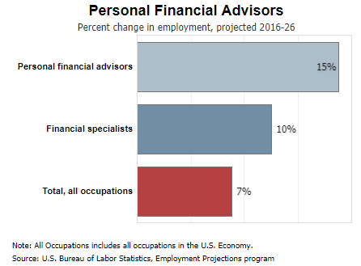
GROWING JOB MARKET
Financial planners are in high demand
Bureau of Labor Statistics projects 15% growth between 2016 and 2026 – 4% higher than other occupations¹
Americans need financial advice
  46% of adults could not cover an emergency expense costing $400, or would cover it by selling something or borrowing money²
  36% of Americans ages 18-34 receive financial help from family members not living with them³
  31% of non-retired respondents have no retirement savings or pension, including 27% of non-retired respondents 60 or older²
Bureau of Labor Statistics, U.S. Department of Labor, Occupational Outlook Handbook, Personal Financial Advisors.
Report on the Economic Well-Being of U.S. Households in 2015, Board of Governors of the Federal Research System, May 2016.
Financial Capability in the United States 2016, FINRA, 2016.
Notes:
There are also countless career opportunities within our profession because the need and demand for financial advice has grown significantly within the last 30 to 40 years.
Consider this: The federal government’s Bureau of Labor Statistics, which researches the state of U.S. employment and labor, projects that the financial advisory industry, including financial planning, will grow 15% between 2016 and 2026. That’s 4% higher growth than other occupations are projected to experience.
This tremendous growth is directly tied to Americans’ increasing realization that they need competent, professional advice about how to manage their personal finances.
Because few people can rely on corporate pensions and Social Security, they must save, invest, and withdraw funds on their own. Unfortunately, as these statistics underscore, many of these people are not able to do so effectively without some assistance.

Slide 12

MULTIPLE PATHWAYS INTO PROFESSION
Financial planning is not a one-size-fits-all career:
Registered Investment Advisory (RIA) Firms (e.g. Edelman, Mariner, RTD Financial Advisors)
Wirehouses (e.g. Morgan Stanley, UBS, Wells Fargo, Merrill Lynch)
Banks (e.g. PNC, SunTrust)
National and Regional Broker Dealers (e.g. Ameriprise, Raymond James)
Insurance Broker Dealers (e.g. Northwestern Mutual, AXA, MassMutual)
Independent Broker Dealers (e.g. Commonwealth Financial Network, Advisor Group, LPL Financial)
Direct Channel (e.g. Vanguard, Fidelity, Charles Schwab)
Notes:
Financial planning also provides tremendous flexibility to shape your own career path.
You may choose to work for a large firm, or a small firm. You might work for a bank or a broker dealer.
Or you might decide to strike out on your own. In fact, roughly one in five personal financial planners were self-employed in 2014, according to the Bureau of Labor Statistics.
SPEAKER CUSTOMIZATION: Briefly describe your own career path within the profession.

Slide 13

REWARDING CAREER
Build your future while helping others
Median income for CFP® professionals ranges from $68,000 to $334,000, depending on the job role and years of experience (lnvestmentNews 2017 Adviser Compensation & Staffing Study report)
Flexibility to balance personal and professional life
Helping people deal with financial challenges and build wealth
Notes:
One of the things I love most about my job is that I have a chance to make a real difference in my clients’ lives. I’m helping them to build wealth, manage financial challenges, and secure their families’ financial futures.
I have been able to do this all while creating a future of my own. As a CERTIFIED FINANCIAL PLANNER™, I’ve been able to build my own business and balance professional demands with my personal life. That’s the kind of flexibility the financial planning profession provides.
It also provides financial rewards. According to the Bureau of Labor Statistics, the median pay for personal financial planners is $89,000 per year.

Slide 14

NEED FOR WOMEN FINANCIAL PLANNERS
Consumers and their financial needs are becoming more diverse; the financial planning profession needs to look more like the clients it will serve
Women control more than a third of the wealth in the U.S.
Only 23% of the 81,000 CFP® professionals are women
Lack of role models is one of two key factors contributing to profession’s current lack of diversity
Notes:
As I mentioned before, there is a clear need for a more diverse financial planning workforce that can serve the needs of its diverse clientele. We need more women to enter our profession to bridge this gap.
Consider that only 23% of current CFP® professionals are women.
More women financial planners are also needed due to the changing demographics of wealth. Women have more money and economic independence than ever before. They’re also the primary inheritors of wealth.
It makes good business sense for financial planning firms and other companies offering financial advice to reflect this same demographic change among their own employee population.
In addition, the more women we have working in the financial planning profession, the more likely other women will choose a career in financial planning. Lack of role models was one of two key factors cited as contributing to the profession’s lack of diversity in a recent study conducted for the Center for Financial Planning. As the saying goes, “People cannot be what they cannot see.”

Slide 15
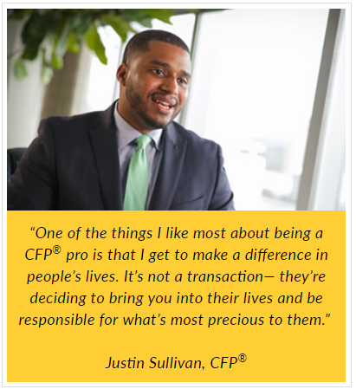
NEED FOR AFRICAN AMERICAN FINANCIAL PLANNERS
Consumers and their financial needs are becoming more diverse; the financial planning profession needs to look more like the clients it will serve
Only 6% of financial advisors are African American, even though African Americans make up 13% of the population
Average net worth of African American families increased by 30% from 2013 to 2016
Lack of role models is one of two key factors contributing to profession’s current lack of diversity
Notes:
As I mentioned before, there is a clear need for a more diverse financial planning workforce that can serve the needs of its diverse clientele. We need more African Americans to enter our profession to bridge this gap.
Consider that only 6% of financial advisors are African American, even though they make up 13% of the U.S. population.
African Americans are also building wealth. According to the Federal Reserve, the average net worth of African American families increased by 30% between 2013 and 2016.
It makes good business sense for financial planning firms and other companies offering financial advice to reflect this same demographic change among their own employee population.
In addition, the more African Americans we have working in the financial planning profession, the more likely other African Americans will choose a career in financial planning. Lack of role models was one of two key factors cited as contributing to the profession’s lack of diversity in a recent study conducted for the Center for Financial Planning. As the saying goes, “People cannot be what they cannot see.”

Slide 16
NEED FOR LATINO FINANCIAL PLANNERS
Consumers and their financial needs are becoming more diverse; the financial planning profession needs to look more like the clients it will serve
By 2060 there will be 114% more Latinos in America than in 2018
Latinos are building wealth; the top fifth of Latinos, or more than 2.1 million households, have an average wealth of more than $400,000
Only 1,500 (2%) of the 81,000 CFP® professionals are Latino
Lack of role models is one of two key factors contributing to profession’s current lack of diversity
Notes:
As I mentioned before, there is a clear need for a more diverse financial planning workforce that can serve the needs of its diverse clientele. We need more Latinos to enter our profession to bridge this gap.
Consider that only 2% of current CFP® professionals are Latino, even though we make up more than 17% of the U.S. population.
Latinos are also building wealth. The top fifth of Latinos – which is more than 2.1 million households – have an average wealth of more than $400,000.
It makes good business sense for financial planning firms and other companies offering financial advice to reflect this same demographic change among their own employee population.
In addition, the more Latinos we have working in the financial planning profession, the more likely other Latinos will choose a career in financial planning. Lack of role models was one of two key factors cited as contributing to the profession’s lack of diversity in a recent study conducted for the Center for Financial Planning. As the saying goes, “People cannot be what they cannot see.”

Slide 17
OPPORTUNITIES FOR PEOPLE OF COLOR
Consumers and their financial needs are becoming more diverse; the financial planning profession needs to look more like the clients it will serve
Average net worth of African American families increased by 30% from 2013 to 2016
The top fifth of Latinos, or more than 2.1 million households, have an average wealth of more than $400,000
By 2060 there will be 114% more Latinos in America than in 2018
Only 6% of financial advisors are African American, and just 2% of the 81,000 CFP® professionals are Latino
Lack of role models is one of two key factors contributing to profession’s current lack of diversity
Notes:
As I mentioned before, there is a clear need for a more diverse financial planning workforce that can serve the needs of its diverse clientele. We need more African Americans and Latinos to enter our profession to bridge this gap.
Consider that African Americans represent only 6% of financial advisors yet comprise more than 13% of the U.S. population.
Similarly, only 2% of current CFP® professionals are Latino, even though we make up more than 17% of the U.S. population. By 2060, it is estimated there will be 114% more Latinos in the U.S. than there are today.
These populations are also building wealth.
According to the Federal Reserve, the average net worth of African American families increased by 30% between 2013 and 2016.
The top fifth of Latinos – which is more than 2.1 million households – have an average wealth of more than $400,000.
It makes good business sense for financial planning firms and other companies offering financial advice to reflect this same demographic change among their own employee population.
In addition, the more African Americans and Latinos we have working in the financial planning profession, the more likely other African Americans and Latinos will choose a career in financial planning. Lack of role models was one of two key factors cited as contributing to the profession’s lack of diversity in a recent study conducted for the Center for Financial Planning. As the saying goes, “People cannot be what they cannot see.”

Slide 18
What is CFP® CERTIFICATION?
3
Notes:
If you haven’t had much exposure to the financial planning profession, you probably aren’t familiar with the term CFP® professional. Let’s talk a little bit about the CFP® certification and what it means to be a CFP® professional.

Slide 19
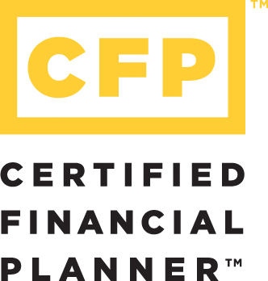
CERTIFIED FINANCIAL PLANNER™ CERTIFICATION
The highest standard for financial planning
Awarded by the Certified Financial Planner Board of Standards
More than 40 years in existence
For professionals who meet education, examination, experience and ethical requirements
Requires compliance with Professional Standards and Code of Ethics
Accredited by National Commission for Certifying Agencies (NCCA)
Over 81,000 CFP® professionals in the U.S.
Notes:
First, CFP stands for CERTIFIED FINANCIAL PLANNER.
The CFP® certification is generally regarded by employers and the public as the highest professional distinction in the financial planning profession.
It is awarded by CFP Board, as I mentioned, and has a more than 40-year history.
In addition to meeting education, examination, experience, and ethical requirements, all CFP® professionals must comply with CFP Board’s Professional Standards and Code of Ethics.
Central to the Standards and Code is the requirement that CFP® professionals act in the best interests of their clients at all times when providing financial advice. This really sets CFP® professionals apart from other financial advisors and is a key part of the reason why CFP® certification is widely seen as the gold standard in personal financial planning.

Slide 20
BENEFITS OF
CFP® cERTIFICATION
4
Notes:
Why does CFP® certification matter? Becoming certified provides a number of benefits that will help you build a successful financial planning career.

Slide 21
VALUED BY CONSUMERS
Consumers see value of working with certified advisors
ORC International, 2013
Notes:
More and more consumers seeking financial planning help are looking for planners of an exceptional quality who adhere to the highest standard.
Research shows that consumers recognize the value of working with certified advisors.
More than 8 in 10 believe that certifications are important when choosing a financial planner.
Nearly 9 in 10 say they would feel more confident working with a financial planner who has a financial planning designation.
Seven out of 10 consumers prefer an advisor who can look at their whole financial situation.

Slide 22
VALUED BY CONSUMERS
CFP® certification is the preferred financial planning designation
2017 Spring Ipsos Brand Tracking Study
Notes:
There are, of course, other industry designations in the financial planning profession, including the well-known CPA designation. However, as this chart shows, the CFP® professional credential is much more preferred by consumers than any other financial planning designation.
They understand that CFP® certification demonstrates a deep knowledge and commitment to personal financial planning.

Slide 23
ENABLES PROFESSIONAL GROWTH
Competency + Confidence + Credibility = The Trusted Advisor
Build competence in a wide range of financial areas
Gain confidence in your abilities, thinking and future
Enhance your credibility with potential clients
of CFP® professionals say CFP® certification has had a positive impact on their knowledge, their confidence with clients, and client trust
Notes:
The knowledge you gain from earning your CFP® certification will help you give better advice to clients. This translates into a more successful career.
CFP® certification provides you with three essential elements you will need to gain trust and earn recognition as the very best in the personal financial planning field.
CFP® certification requirements are broad-based, so you build competence in a wide range of financial areas enabling you to see the big picture and think holistically.
In pursuing the highest standard in the financial planning field, you will gain increased confidence in your abilities, in your thinking and in your future.
Having the ability to put what you learn into practice provides solid evidence that you are able to provide unique strategies that fit individual circumstances and enhance your credibility.
70% of CFP® professionals say that CFP® certification has had a positive impact on their knowledge, their confidence with clients, and client trust.

Slide 24
INCREASES EARNING POTENTIAL
AVERAGE 2014 COMPENSATION BY ADVISOR YEARS OF EXPERIENCE (US$)
AITE Group, January 2016 Study—Building a Wealth Management Practice: Measuring CFP® Professionals’ Contribution
Notes:
An even more telling statistic is income potential: CFP® professionals earn more than their counterparts. In fact:
Those with less than nine years of experience make 31% more than those without CFP® certification.
Those with 9 to 17 years of experience make 14% more than their counterparts.
Those with 18 or more years of experience earn 33% more than those without CFP® certification.
Furthermore, a comprehensive study on the contribution of CFP® professionals in wealth management firms shows that team-based practices led by CFP® professionals generate 44% more revenue.
Likewise, CFP® professionals in solo practice generate 40% more revenue based on average practice revenue.

Slide 25
WHAT CFP® PROS SAY
91% are very satisfied with their decision to pursue CFP® certification, with 76% giving the highest rating to certification satisfaction
83% say CFP® professionals have a "competitive edge" over financial planners who do not hold the credential
77% of respondents strongly agree that the CFP® certification contributes directly to their own professional success
66% say that becoming a CFP® professional had a positive impact on their income
91% would recommend the CFP® certification to other financial professionals
CFP Board 2017 Survey of CFP® Professionals
Notes:
I am not the only CFP® professional who sees the value of CFP® certification.
According to a recent CFP Board survey of CFP® professionals:
91% are very satisfied with their decision to pursue CFP® certification, with 76% giving the highest rating to certification satisfaction
83% say CFP® professionals have a "competitive edge" over financial planners who do not hold the credential
77% of respondents strongly agree that the CFP® certification contributes directly to their own professional success
66% say that becoming a CFP® professional had a positive impact on their income
91% would recommend the CFP® certification to other financial professionals

Slide 26
How to become a Cfp® proFESSIONAL
5

Slide 27

CREATE AN ACCOUNT WITH CFP BOARD
CFP.net/Account
Get the latest information on certification requirements
Receive guidance from CFP Board
Access helpful career resources:
  Career Center
  Candidate Forum
  Mentorship
Notes:
For those who are just beginning their path to becoming a financial planner and earning CFP® certification, there are many options for meeting the education requirement.
Nearly 200 colleges and universities currently offer more than 300 undergraduate, graduate, certificate, and doctorate programs the cover the topics required for the CFP® exam.
These topics include financial planning, insurance planning and risk management, estate planning, retirement planning, investments, income tax payments, and employee benefits.
These programs also include a capstone course on financial plan development.
I encourage you to visit CFP.net/Education to find the best program for you.

Slide 28
THE FOUR E’S OF CERTIFICATION
4 “E’s”
Education
Examination
Experience
Ethics
Computer-based
Offered 3 Times/Year
170 Questions
Financial Planning Coursework
63.7% Average Pass Rate in 2017
Bachelor’s Degree
Financial Planning Coursework
Challenge Status
Traditional Pathway (3 years)
Apprenticeship Pathway (2 years)
Background Check
Code of Ethics
Fiduciary Standard
Notes:
As I mentioned, the requirements to become a Certified Financial Planner™ professional are among the highest and most comprehensive for any profession.
These requirements are based on 4 “E’s”:
Education - A bachelor’s degree and completion of college-level courses on major personal financial planning topics. More than 240 institutions offer educational programs to satisfy education coursework requirement. All programs cover the same core curriculum, yet vary in style, length and delivery method. For example, programs are available in-person or online, and as certificate or graduate programs. If you have one of the designated degrees, licenses or credentials, such as CPA or CFA, you are eligible to forego the coursework and just complete a capstone course registered with CFP Board.
Examination - Passing a 6 hour computer-based exam with 170 questions. The exam is offered 3 times per year and the average pass rate in 2017 has been 63.7%.
Experience - Three years or more qualifying work experience in financial planning, or a two-year apprenticeship option. The apprenticeship option is available to candidates who deliver all elements of financial planning directly to clients
And work under direct supervision of a CFP® professional.
Ethics – Passing a background check and commitment to an ethical code that includes the fiduciary duty to act in the best interest of the client at all times when providing financial advice.

Slide 29

EDUCATION REQUIREMENT FOR CFP® PROS
Earn a bachelor’s degree and complete college-level courses on major personal financial planning topics
313 financial planning programs at 192 colleges and universities
Offered as undergraduate, graduate, certificate and doctorate programs
Cover topics required for CFP® exam: financial planning, insurance planning and risk management, estate planning, retirement planning, investments, income tax payments, employee benefits
Include a capstone course on financial plan development
Find a program at CFP.net/Education
Notes:
For those who are just beginning their path to becoming a financial planner and earning CFP® certification, there are many options for meeting the education requirement.
Nearly 200 colleges and universities currently offer more than 300 undergraduate, graduate, certificate, and doctorate programs the cover the topics required for the CFP® exam.
These topics include financial planning, insurance planning and risk management, estate planning, retirement planning, investments, income tax payments, and employee benefits.
These programs also include a capstone course on financial plan development.
I encourage you to visit CFP.net/Education to find the best program for you.

Slide 30
resources
6
Notes:
Should you decide to pursue a career in financial planning and CFP® certification, a variety of resources are available through CFP Board and the Center to help you along the way.

Slide 31
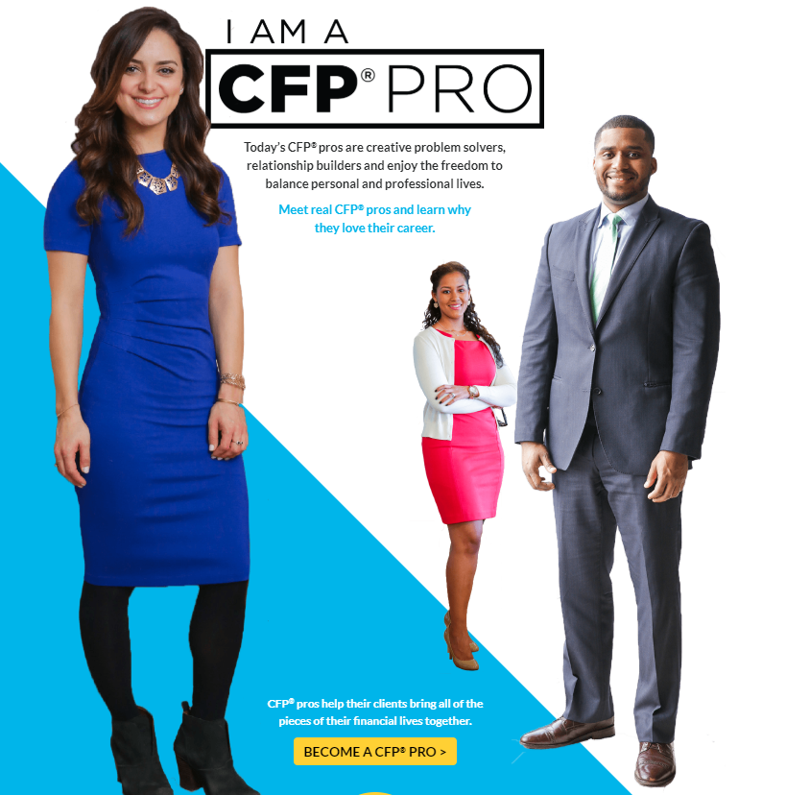
“I AM A CFP® PRO” CAMPAIGN
Learn about financial planning careers and how to become a CFP® pro
Focus on young people
See videos and stories from CFP® pros and why they chose to become financial planners
Access resources to help you get started on your path
Notes:
Last year, the Center for Financial Planning launched the “I Am a CFP® Pro” campaign to encourage young adults – particularly Latinos, African Americans, and women – to pursue financial planning careers.
Videos – including the one we watched earlier – and stories shared by CFP® professionals on social media share the benefits of financial planning careers and explain why they chose to become financial planners.
The campaign’s website provides resources and information for those interested in learning more about financial planning careers and how to become a CFP® professional.

Slide 32

SCHOLARSHIP PROGRAMS
The Milton Stern Scholars Fund
For New York, New Jersey, or Connecticut residents seeking to complete a CFP Board Registered Program
The Deena Jo Heide-Diesslin Foundation Challenge Match Scholarship
For individuals from underrepresented populations within the financial planning profession who are pursuing CFP® certification
Richard B. Wagner Memorial Scholarship
For prospective CFP® professionals seeking to complete a CFP Board Registered Program and new CFP® professionals who want to continue their professional advancement; focused on underrepresented populations with financial need
Notes:
The Center for Financial Planning administers scholarship programs to enable qualified individuals to start or complete the education requirement for attaining CFP® certification.
The Milton Stern Scholars Fund offers scholarships to qualified students who are residents of New York, New Jersey, or Connecticut, and who are seeking to complete a CFP Board-Registered Certificate Program that qualifies them to take the CFP® exam.
The Deena Jo Heide-Diesslin Foundation Challenge Match Scholarship offers scholarships to qualified individuals who have demonstrated a financial need, or are part of underrepresented populations within the financial planning profession in terms of gender, race, ethnicity, disability or sexual orientation.
The Richard B. Wagner Memorial Scholarship Fund similarly offers scholarships to qualified individuals from an underrepresented population and who have demonstrated a financial need. It is also open to new CFP® professionals desiring to advance their education through key FPA professional development programs, such as the FPA Retreat, Residency, NexGen Gathering, Annual Conference and mentorship opportunities.

Slide 33

CFP BOARD MENTOR PROGRAM
One-on-one guidance and support from an experienced CFP® professional
More than 600 CFP® professionals volunteering as mentors
Professional development support and guidance through CFP® certification process
More than 1,600 mentor-mentee engagements facilitated
To sign up: CFP.net/Career-Center
Notes:
The CFP Board Mentor Program can connect you with an experienced CFP® professional who will provide one-on-one professional development support and guidance through the CFP® certification process.
More than 600 CFP® professionals currently volunteer as mentors through this program, which has facilitated more than 1,600 mentor-mentee engagements to date.
You can sign up to be matched with a mentor at CFP.net/Career-Center.

Slide 34
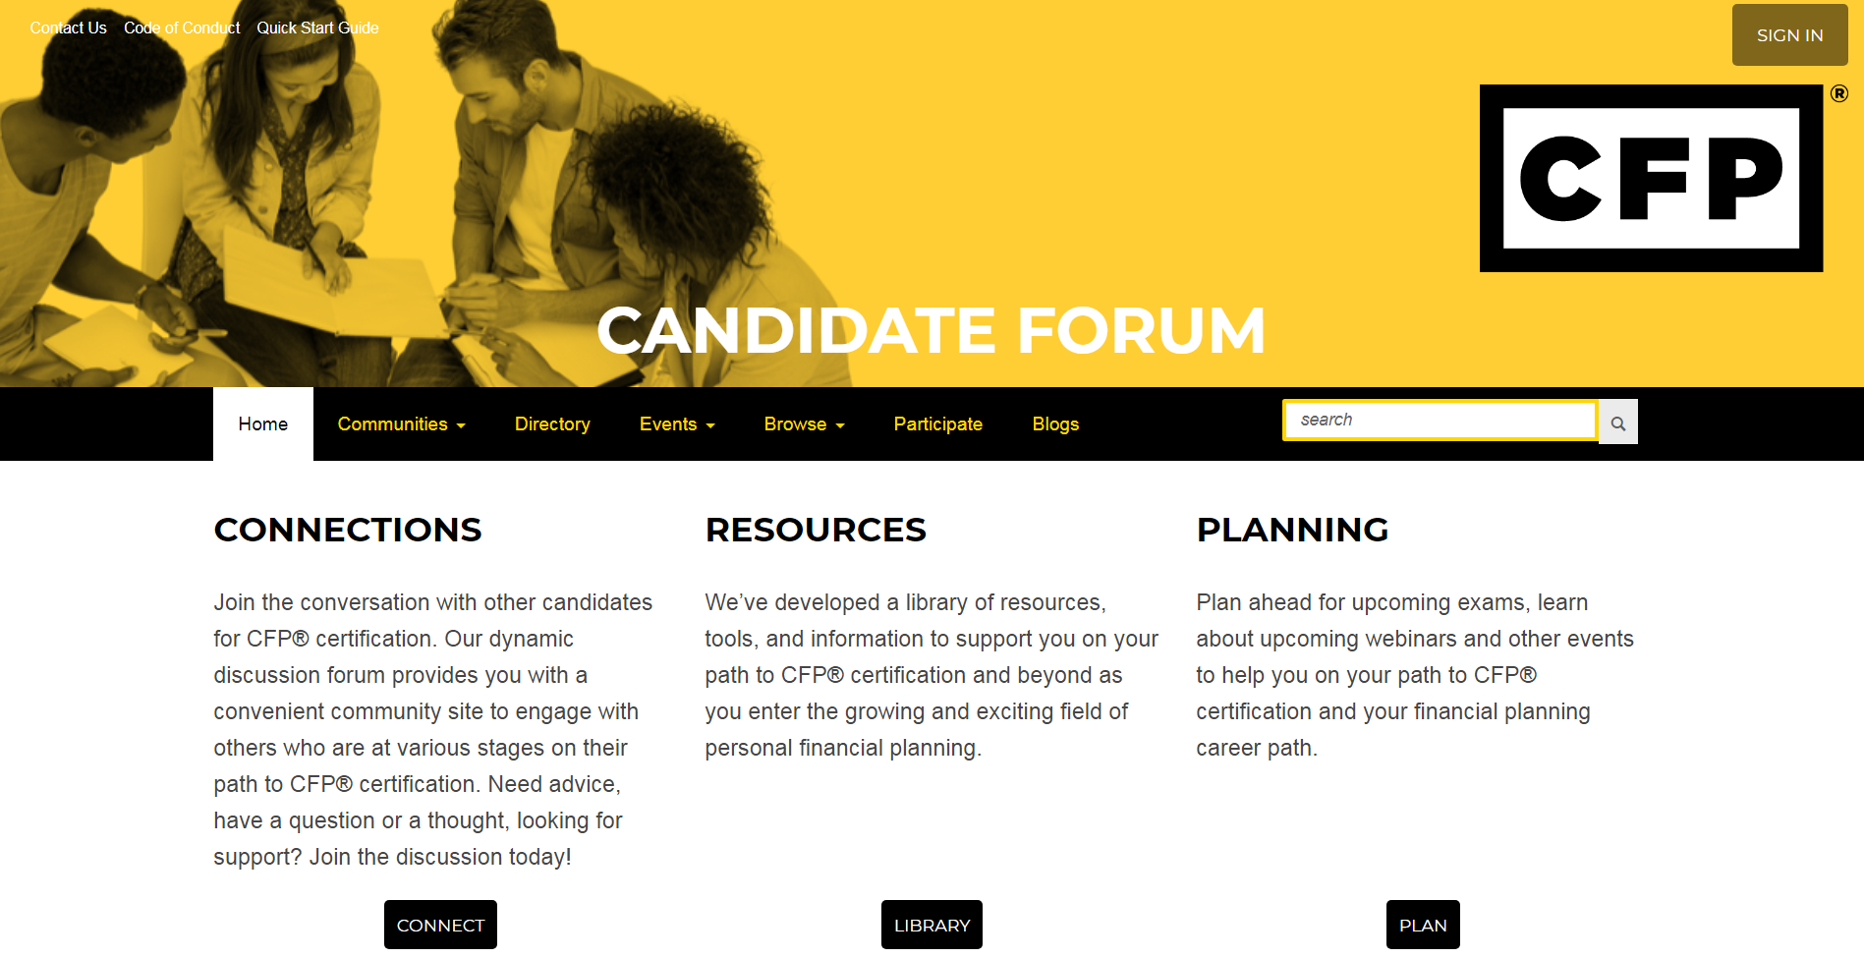
CANDIDATE FORUM
Connect and engage in dynamic conversation with other candidates for CFP® certification
Access library of resources, tools, and information to support your path to CFP® certification
Ask questions, get advice and support, and participate in live “Ask the Expert” events
Notes:
Through the online CFP Board Candidate Forum, you can connect and engage in dynamic conversation with other CFP® candidates.
The forum also provides access to a library of resources, tools, and other information to support you on your path to CFP® certification.
In addition, you can learn about upcoming webinars, exams, and other events.

Slide 35
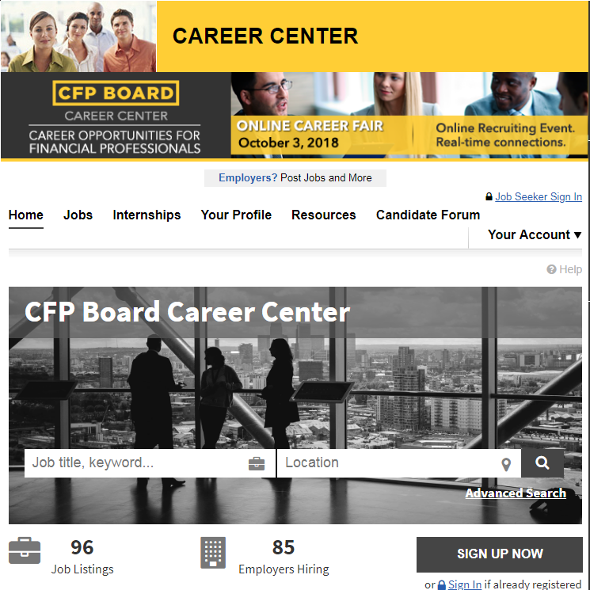
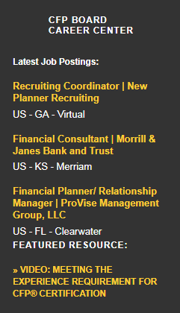
CFP BOARD CAREER CENTER
Free access to jobs of all experience levels and internship opportunities with leading firms
Online Career Fairs that connect you with potential employers
Notes:
CFP Board’s Career Center is another great resource. It provides free access to job and internship opportunities with leading firms across the financial planning profession.
The Career Center also hosts regular Online Career Fairs that connect prospective employees with potential employers.
In addition, the Career Center produces informative, free webinars that provide insight and advice on career development.

Slide 36
Questions?

